Slide 1
CLASS 06: BUILD PROGRAM LOGIC(04)
Intro jump statements

Slide 2
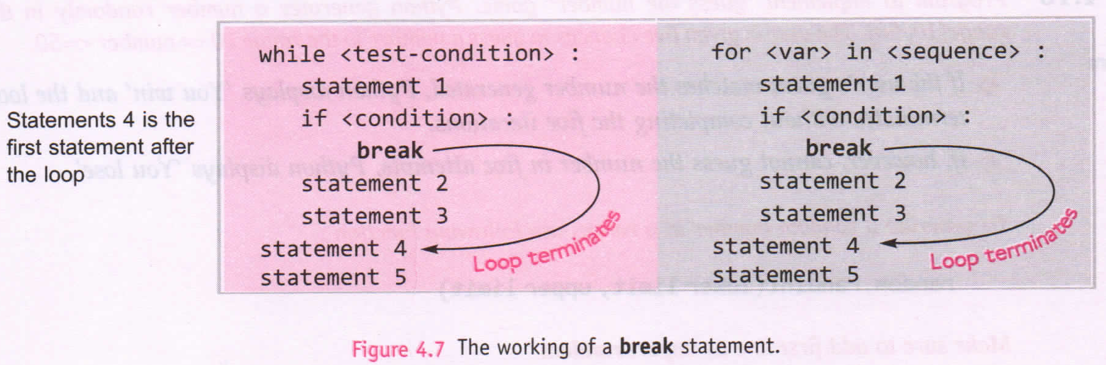
Jump statements: break
The break statement enables program to skip over a part of the code.
A break statement immediately following the body of the terminated statement.

Slide 3
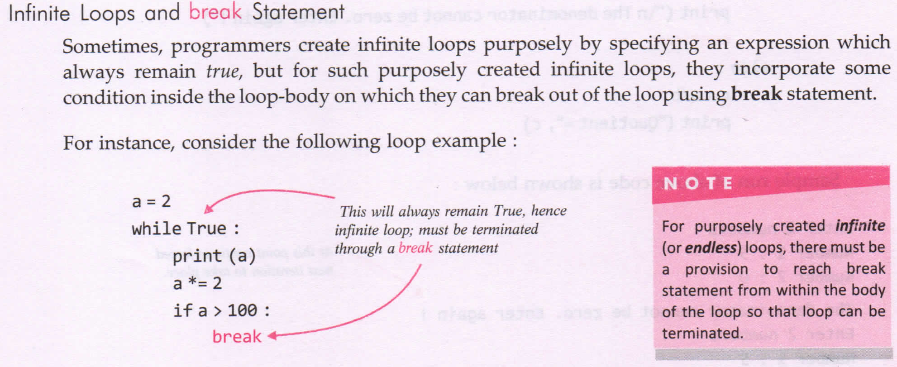

Slide 4
Quotient Error Program
Perform division of two user input number. Ask the user how many divisions is to be performed and if any quotient encountered use break statement and stop the process immediately.

Slide 5
Jump Statement: continue
Continue is another jump statement like break statement as both skip a part of the code.
But continue is somewhat different from break.
Instead of forcing the termination, the continue statement forces the next iteration of the loop to take place, skipping any code in between.

Slide 6
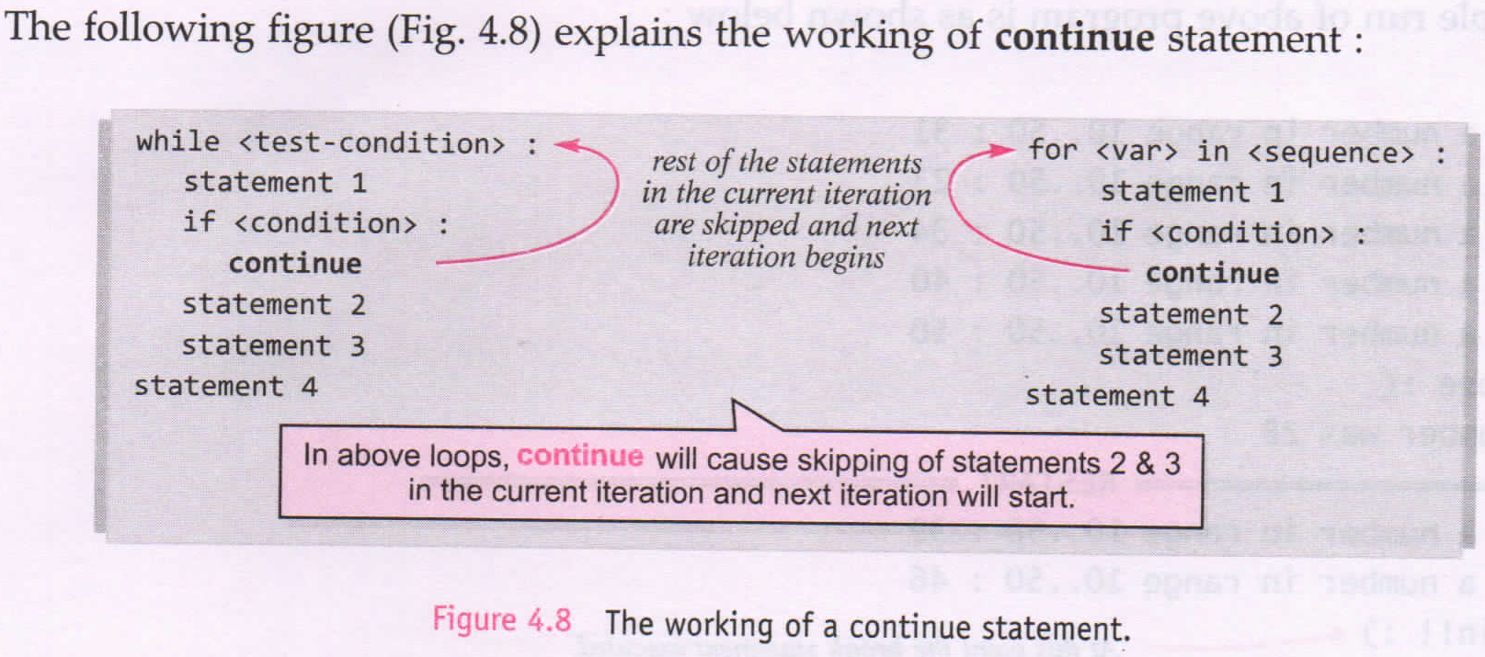

Slide 7
Quotient Error Program
Perform division of two user input number. Ask the user how many divisions is to be performed and if any quotient encountered to be illegal, use continue statement and go for next iteration.

Slide 8
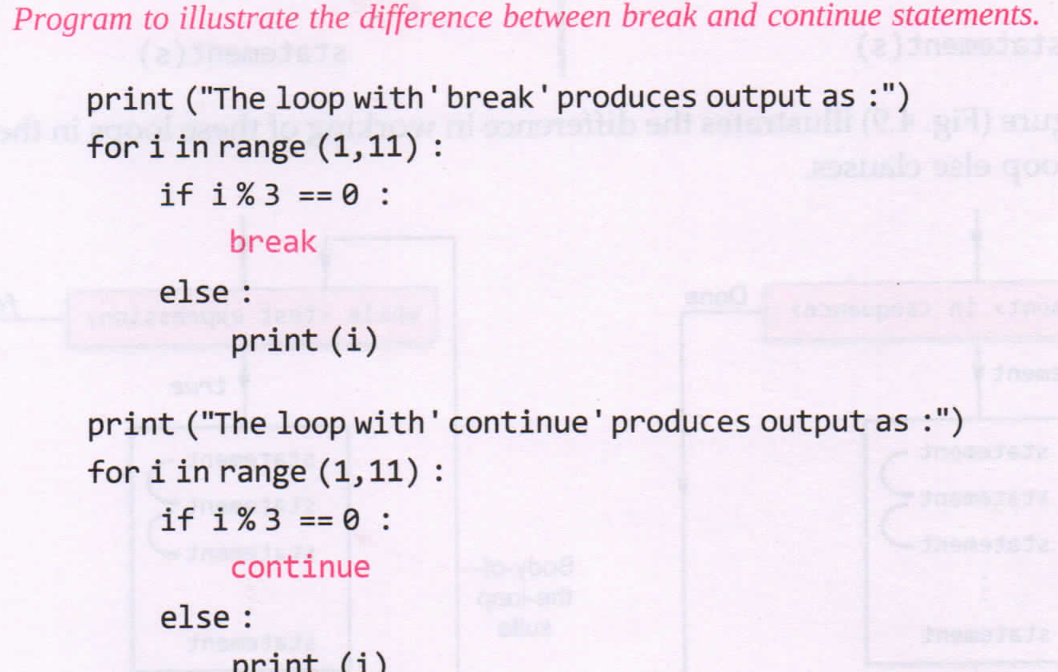
Summary for jump statement

